Slide 1
Software Construction and Development
Design Principles in Java (Solid, Dry, Kiss)
Khizar Hayat
Email: Khizer.hayat@ucp.edu.pk
Office: Building D, 2^{nd Floor}
OFFICE HOURS: Friday (9:00 to 11:00)

Slide 2
SOLID
SOLID is an acronym for five core object-oriented design principles:
  S – Single Responsibility Principle
  O – Open/Closed Principle
  L – Liskov Substitution Principle
  I – Interface Segregation Principle
  D – Dependency Inversion Principle

Slide 3
Single Responsibility Principle (SRP)
A class should have only one reason to change.
That means: One class = One job.
Example :
public class Invoice {
public void calculateTotal() { /* logic */ }
public void printInvoice() { /* logic */ }
public void saveToDatabase() { /* logic */ }
}

Slide 4
Single Responsibility Principle (SRP)
Clean Code:
public class Invoice {
public double calculateTotal() { /* logic */ return 0; }
}
public class InvoicePrinter {
public void print(Invoice invoice) { /* logic */ }
}
public class InvoiceRepository {
public void save(Invoice invoice) { /* logic */ }
}
Everyone has one job. That’s clean architecture.

Slide 5
Open/Closed Principle (OCP)
Software entities should be open for extension, but closed for modification.
That means: You should be able to add new behavior without changing existing code.
Bad Example (using if for logic)
public class PaymentProcessor {
public void process(String method) {
if (method.equals("CreditCard")) { /* logic */ }
else if (method.equals("PayPal")) { /* logic */ }
}
}
Every time you add a method, you modify this class.

Slide 6
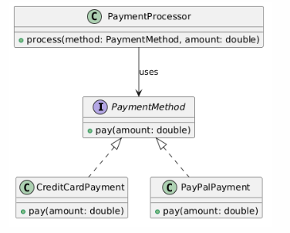
Clean Code
public interface PaymentMethod {
void pay(double amount);
}
public class CreditCardPayment implements PaymentMethod {
public void pay(double amount) { /* logic */ }
}
public class PayPalPayment implements PaymentMethod {
public void pay(double amount) { /* logic */ }
}
//It doesn’t care how the payment is done — it just calls pay() on any object that follows the PaymentMethod interface.
public class PaymentProcessor {
public void process(PaymentMethod method, double amount) {
method.pay(amount);
}
}
Now, to add a new payment method, you create a new class, without touching existing logic.

Slide 7
Liskov Substitution Principle (LSP)
Subtypes must be substitutable for their base types.
That means: Anywhere you use a base class/interface, you should be able to use any subclass without breaking behaviour.
Example:
public class Bird {
public void fly() { }
}
public class Ostrich extends Bird {
@Override
public void fly() {
throw new UnsupportedOperationException("Ostriches can't fly");
}
}
Ostrich is not a true subtype of Bird here — it breaks the expectation.

Slide 8
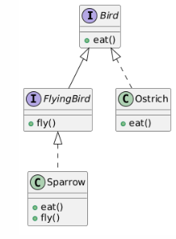
Clean Code
public interface Bird {
void eat();
}
public interface FlyingBird extends Bird {
void fly();
}
public class Sparrow implements FlyingBird {
public void eat() { }
public void fly() { }
}
public class Ostrich implements Bird {
public void eat() { }
}
Now the behavior is correctly separated

Slide 9
Interface Segregation Principle (ISP)
Interface Segregation Principle (ISP) clients should not be forced to depend on interfaces they do not use.
That means: Split large interfaces into smaller, specific ones.
Instead of having one big interface with lots of unrelated methods, break it into smaller, more specific interfaces. Each class should only implement the interface(s) it actually needs.
Example:
public interface Worker {
void work();
void eat();
}
public class Robot implements Worker {
public void work() { }
public void eat() {
// Robots don't eat
throw new UnsupportedOperationException();
}
}

Slide 10
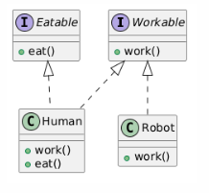
Clean Code
public interface Workable {
void work();
}
public interface Eatable {
void eat();
}
public class Human implements Workable, Eatable {
public void work() { }
public void eat() { }
}
public class Robot implements Workable {
public void work() { }
}
Now each class only implements what it needs.

Slide 11
Dependency Inversion Principle (DIP)
High-level modules should not depend on low-level modules.
Both should depend on abstractions.
Abstractions should not depend on details. Details should depend on abstractions.
Instead of a class directly creating or depending on another class, it should depend on an interface (abstraction). This makes your code easier to change, test, and extend.

Slide 12
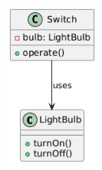
Bad Example (tight coupling)
public class LightBulb {
public void turnOn() { }
public void turnOff() { }
}
public class Switch {
private LightBulb bulb = new LightBulb();
public void operate() {
bulb.turnOn();
}
}
Switch is tightly coupled to LightBulb.

Slide 13
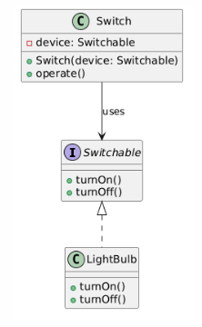
Clean code
public interface Switchable {
void turnOn();
void turnOff();
}
public class LightBulb implements Switchable {
public void turnOn() { }
public void turnOff() { }
}
public class Switch {
// a variable that can hold any object that implements Switchable
private Switchable device;
// This is the constructor of the Switch class and receives switchable object as parameter. The passed object is stored in private variable device.
public Switch(Switchable device) {
this.device = device;
}
public void operate() {
device.turnOn();
}
}
Now Switch can work with any device — it depends on an abstraction, not a specific implementation.

Slide 14
Summary
Principle | Meaning | Clean Code Goal
SRP | One reason to change | Keep classes focused
OCP | Extend, don’t modify | Add new behavior safely
LSP | Subtypes behave like base | Reliable polymorphism
ISP | Only depend on what you use | Avoid bloated interfaces
DIP | Depend on abstractions | Reduce tight coupling

Slide 15
DRY(Don’t Repeat Yourself)
"Avoid duplication in logic, structure, and intent. Duplicated code is a maintenance burden and a source of bugs”
BAD Example (Violates DRY)
public class EmployeeService {
public double calculateBonus(String grade, double salary) {
if (grade.equals("A")) {
return salary * 0.10;
} else if (grade.equals("B")) {
return salary * 0.08;
} else {
return salary * 0.05; } }
public void printBonusReport(String name, String grade, double salary) {
double bonus;
if (grade.equals("A")) {
bonus = salary * 0.10;
} else if (grade.equals("B")) {
bonus = salary * 0.08;
} else {
bonus = salary * 0.05; }
System.out.println(name + "'s bonus is: " + bonus); } }

Slide 16
Clean Code:
public class EmployeeService {
public double calculateBonus(String grade, double salary) {
switch (grade) {
case "A": return salary * 0.10;
case "B": return salary * 0.08;
default: return salary * 0.05;
}
}
public void printBonusReport(String name, String grade, double salary) {
double bonus = calculateBonus(grade, salary); // Reuse logic
System.out.println(name + "'s bonus is: " + bonus);
}
}
Bonus calculation logic is now in one place only

Slide 17
KISS (Keep It Simple, Stupid)
"The code should do what it needs to do — no more, no less. Avoid clever tricks, over-engineering, or complicated logic. Favor simplicity and readability.“
BAD Example (Violates KISS)
public class DiscountCalculator {
public double calculate(double price, String userType, int loyaltyPoints) {
if ((userType.equals("PREMIUM") && loyaltyPoints > 100) ||
(userType.equals("REGULAR") && loyaltyPoints > 200) ||
(userType.equals("GUEST") && price > 500)) {
return price * 0.9;
} else {
return price;
}
}
}

Slide 18
Clean Code
public class DiscountCalculator {
public boolean isEligibleForDiscount(String userType, int loyaltyPoints, double price) {
switch (userType) {
case "PREMIUM":
return loyaltyPoints > 100;
case "REGULAR":
return loyaltyPoints > 200;
case "GUEST":
return price > 500;
default:
return false;
}
}
public double calculate(double price, String userType, int loyaltyPoints) {
if (isEligibleForDiscount(userType, loyaltyPoints, price)) {
return price * 0.9;
}
return price;
}
}

